Slide 1

Careers with BS in Physics
Susan Zandrow
ACES Career Advisor | Spring 2023 susan.zandrow@umb.edu
Jobs and Skills
Campus Center | 1st Floor | Suite 1300 | (617) 287-5500

Slide 2
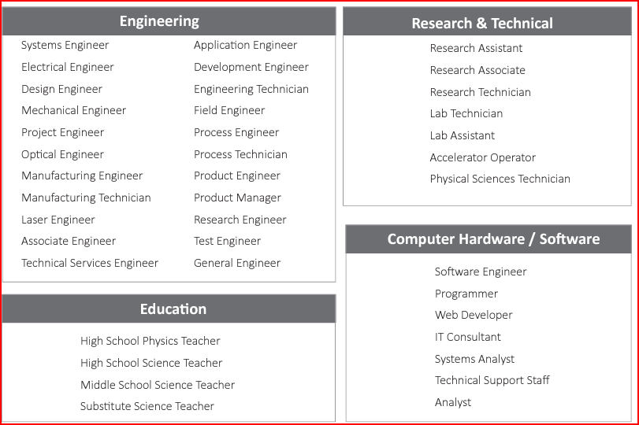
Common Jobs for Physics Majors
AIP Statistical Research Survey, 2017, https://www.aip.org/

Slide 3
Entry Level Jobs for Physics Majors
Research Assistant: Undergraduate physics majors can work as research assistants in academic or industrial research labs. These positions may involve assisting with experiments, collecting data, and analyzing results.
Technical Writer: Many physics majors have strong communication skills and may be able to work as technical writers for science publications, scientific journals, or technical documentation for scientific equipment.
Software Engineer: Physics majors often have strong programming skills and can work as software engineers, developing and testing software for a variety of industries.
Data Analyst: Physics majors may have experience in data analysis and statistics, making them well-suited for data analyst roles in a variety of industries. You can use your analytical skills to analyze large data sets in fields such as finance, healthcare, or technology.
-(ChatGPT, 2023)

Slide 4
Additional Jobs for Physics Majors
Science Educator: Many physics majors have a passion for teaching and can work as science educators, either in a classroom or as a science communicator for museums or other educational institutions.
Patent Attorney: Physics majors may be well-suited for a career in patent law, where they can use their scientific knowledge to help companies protect their intellectual property.
Engineer: You can work as an engineer in fields such as aerospace, electronics, materials science, or mechanical engineering.
Medical Physicist: You can work in healthcare, applying physics principles to diagnose and treat patients with radiology
Science Communicator: You can work in science communication, helping to translate scientific concepts for the public through writing, editing, or multimedia production.
Source: ChatGPT, 2023

Slide 5
Physic Majors Statistics
About 55% of physics BS recipients in the US find employment in a physics-related field within 6 months of graduation.
  research and development, education, and technical services
12% of physics bachelor's degree recipients find employment in other fields
  finance or engineering
About 42% of physics bachelor's degree recipients in the United States go on to earn a higher degree, such as a master's or doctorate.
  Of those who pursue advanced degrees, about 76% earn a master's degree and about 44% earn a doctorate.
American Institute of Physics, https://www.aip.org/

Slide 6


Slide 7
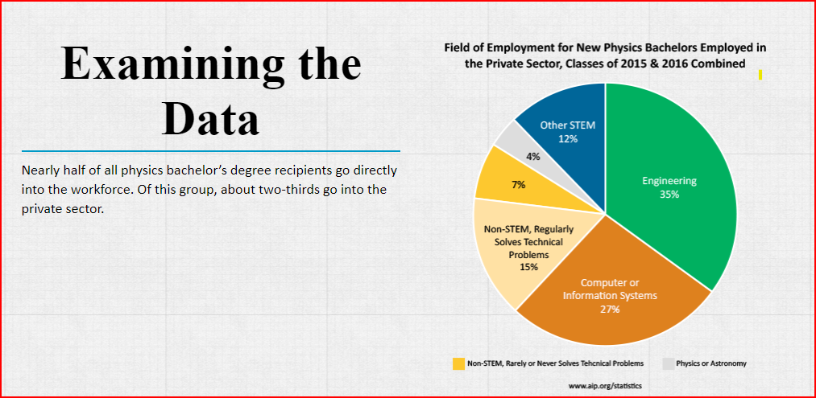

Slide 8
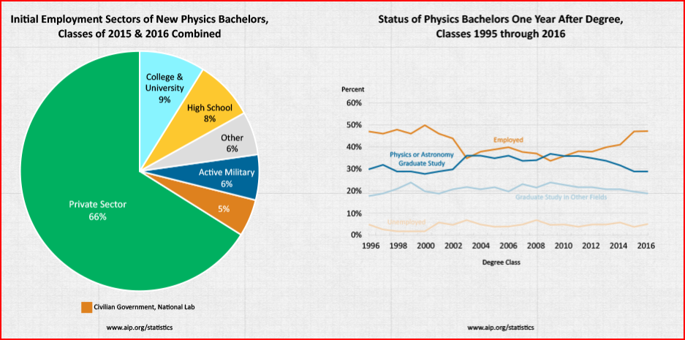

Slide 9
Entry Level Salary for Undergrad Physics Majors in Boston
Here are some average entry-level salaries for common job titles that physics majors may pursue in Boston:
Research Assistant: $40,000 to $60,000 per year
Data Analyst: $50,000 to $70,000 per year
Software Engineer: $60,000 to $80,000 per year
Medical Physicist: $70,000 to $90,000 per year
Radiation Therapist: $70,000 to $90,000 per year
Engineer: $80,000 to $100,000 per year
Salary varies depending on factors such as industry, job title, and level of experience.
According to data from the US Bureau of Labor Statistics, the median annual wage for all physicists and astronomers in the Boston-Cambridge-Nashua metropolitan area was $119,690 as of May 2020.
Source: Chat GPT

Slide 10
Major Employers of Entry Level Physics Majors
National Aeronautics and Space Administration (NASA): NASA is a federal agency that conducts research and development in aerospace technology and space exploration. Physics undergraduate majors can work as engineers, researchers, or data analysts in fields such as astrophysics, atmospheric science, and spacecraft design.
Department of Energy (DOE): The Department of Energy is a federal agency that is responsible for energy policy and research. Physics undergraduate majors can work as research scientists, engineers, or data analysts in fields such as nuclear energy, energy storage, and renewable energy.
Defense contractors: Defense contractors such as Raytheon, Lockheed Martin, and Boeing hire physics undergraduate majors for roles in research and development, engineering, and data analysis. They work on a variety of projects related to national security and defense.
National Laboratories: The US government operates several national laboratories, including Los Alamos National Laboratory, Argonne National Laboratory, and Lawrence Livermore National Laboratory. Physics undergraduate majors can work as researchers or engineers in fields such as nuclear physics, materials science, and high-performance computing.
Healthcare industry: Physics undergraduate majors can work in the healthcare industry as medical physicists, radiation therapists, or imaging specialists. They work in hospitals, clinics, and research laboratories to develop and use advanced technologies for diagnosis and treatment.
Technology industry: Companies in the technology industry such as Google, Amazon, and Apple hire physics undergraduate majors for roles in software development, data analysis, and research and development. They work on a variety of projects related to artificial intelligence, machine learning, and data science.
From Chat GPT
Massachusetts employers who recently hired new physics Bachelor of Science recipients:
https://www.aip.org/statistics/massachusetts
AIP, 2020

Slide 11
Boston Major Companies Hiring Physics Majors
Massachusetts General Hospital (MGH): MGH is a leading healthcare institution in Boston that employs physicists in its radiation oncology and imaging departments. Physics majors can work as medical physicists or radiation therapists.
Draper: Draper is an engineering firm that specializes in developing advanced technologies for government and commercial clients. Physics majors can work as engineers in fields such as aerospace, defense, and biomedical engineering
Amazon Robotics: Amazon Robotics is a division of Amazon that develops robotics and automation technologies for its warehouses and fulfillment centers. Physics majors can work as robotics engineers, data analysts, or software developers.
Raytheon: Raytheon is a defense contractor that develops advanced technologies for the military and other government agencies. Physics majors can work as engineers, scientists, or data analysts in fields such as missile defense, cybersecurity, and intelligence.
Bose Corporation: Bose is a consumer electronics company that specializes in audio equipment and noise-canceling technologies. Physics majors can work as research scientists, engineers, or data analysts in areas such as acoustics, signal processing, and machine learning.
Vertex Pharmaceuticals: Vertex is a biotech company that specializes in developing treatments for serious diseases such as cystic fibrosis. Physics majors can work as research scientists or data analysts in areas such as drug discovery, protein engineering, and computational biology.
Analogic Corporation: Analogic is a leading technology company that specializes in medical imaging and security systems. They have previously hired physics majors for various roles such as design engineering, product development, and software engineering.
Ginkgo Bioworks: Ginkgo Bioworks is a biotechnology company that specializes in synthetic biology. They have previously hired physics majors for roles such as research and development, data analysis, and software engineering.
Source: Chat GPT
775 MA companies hiring Physics majors: https://www.buzzfile.com/Major/Physics/MA

Slide 12
Challenges to Getting Physics Entry Jobs
Although there are many jobs for physics bachelor’s degree recipients, very few have the word “physics” in the title
Hiring professionals and professors may not understand what a physics student actually knows or is capable of doing outside of academia
Students may lack self-awareness of or have difficulty articulating their strengths and capabilities
Underdeveloped interpersonal communication skills may be a barrier to students in the job search

Slide 13
UMB Alumni Physics BS Job Titles
Title | Title | Title | Title
Field engineer | HS Teacher | New Product Developer | Auditor
Software engineer | Lecturer –College level | Machinist | Sales Executive
Application engineer | Professor | Radiation Physicist | Medical Dosimetrist
Research engineer | Research Scientist | Sr. Systems Administrator | Marketing Director
QA engineer | Computer Science Engineer | Lab supervisor | Staff scientist
Source: BeaconConnect | Development Project Manager | Patent Examiner | Physicist

Slide 14
UMB Alumni BS Physics Places of Work
A-B Lasers Inc. | Bose
Accenter | LSM Consulting | Entegris, Inc. | General Electric | Goodrich | Hughes Electronics
Air Force | Commonwealth Care Alliance | Cubic Transportation System | Granite Telecommunications | Joint Center for Radiation Therapy | Merrimack College, Massasoit CC
High Schools | Dotmatics Inc. | Franklin Institute | Holometrix Inc | Maine Medical Center | MIT Lincoln Laboratory
Polaroid Corp. | Radiation Monitoring Devices, Inc. | Raytheon | Renesys Corp. | The Mitre Corp. | Thermatron Engineering
Verizon Corp. | Vistaprint | Wire Technology | US Customs | N & K Technology, Inc. | UMB
Source: BeaconConnect | AER, Inc. | Analytical Power Corp. | Monitronics | QC Optical | US Patent Office

Slide 15
Some Possible Skills for Physics Major Resume
Physics
Mathematical Modeling
Data Analysis
Laboratory Techniques
Experimental Design
Computer Programming (e.g., Python, MATLAB, C++)
Scientific Research
Technical Writing
Critical Thinking
Problem-solving
Creative Thinking
Attention to Detail
Communication Skills
Quantum Mechanics
Thermodynamics
Electromagnetism
Classical Mechanics
Statistical Mechanics
Astrophysics
Nuclear Physics
Particle Physics
Condensed Matter Physics
Optics
Computational Physics
Radiation
Analytical skills
Presentation skills
Teamwork/collaboration
Mathematical proficiency
Research and Development

Slide 16

Sample Entry Level Physics Job Descriptions
https://g.co/kgs/nVpJz1
https://g.co/kgs/XJDLLb
https://g.co/kgs/rKhvXi
https://g.co/kgs/Z3ioYt
https://www.indeed.com/q-Entry-Level-Physics-l-Boston,-MA-jobs.html?vjk=ba22724dc02b7629

Slide 17
Physics Job Search Resources
Massachusetts employers who recently hired new physics bachelor recipients: https://www.aip.org/statistics/massachusetts
Society of Physics Students Toolbox: https://www.spsnational.org/sites/all/careerstoolbox/
https://www.spsnational.org/career-resources
https://www.spsnational.org/career-resources/physicist-profiles
https://www.aps.org/careers/physicists/profiles/
https://www.aip.org/diversity-initiatives/team-up-task-force
Video: I just Graduated. What Do I Do Now? Great info! https://www.spsnational.org/webinar-i%E2%80%99m-about-graduate-%E2%80%93-what-earth-do-i-do-now

Slide 18
ACES: Academic & Career
Engagement and Success
Campus Center, first floor, suite 1300
careers@umb.edu | 617-287-5500
Drop-ins during the academic year
Schedule an appointment here: https://www.umb.edu/academics/vpass/aces
Office is open all year round
ACES offers: Resume/cover letter reviews, job/internship searches/ interviewing skills, major selection and career paths, networking, Career Expos and workshops and more
We look forward to working with you!
The ACES Team

